Slide 1
www.teachinggamesefl.com
These templates are to accompany an article
For more details and instructions go to: www.teachinggamesefl.com
mikeastburyteaching@gmail.com

Slide 2

Example 1
1
2
3
4
5
6
7
8
9

Slide 3
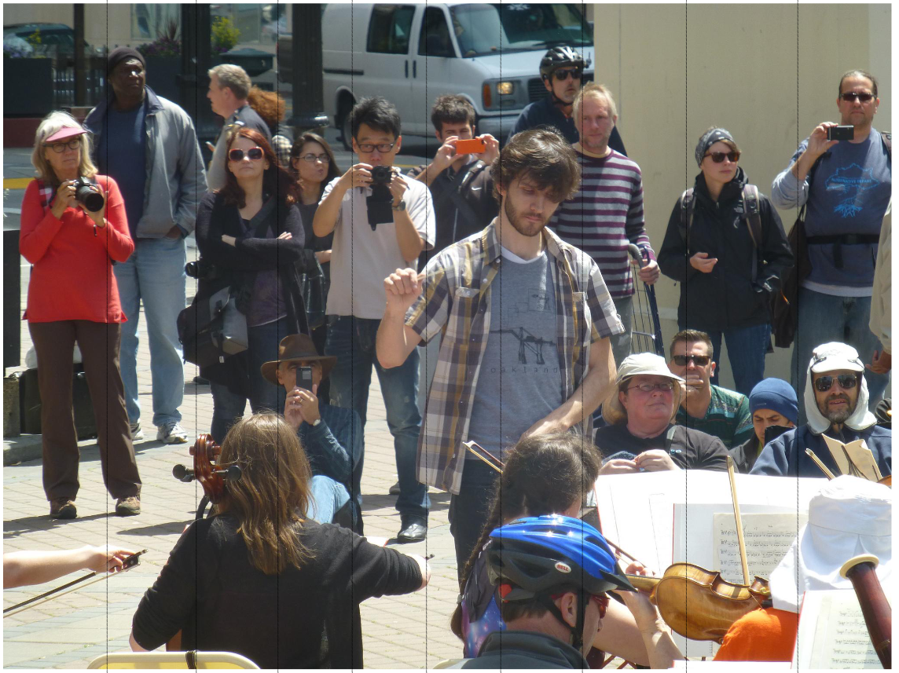
Example 2
1
2
3
4
5
6
7
8
9
10

Slide 4
Custom template
1
2
3
4
5
6
7
8
9

Slide 5
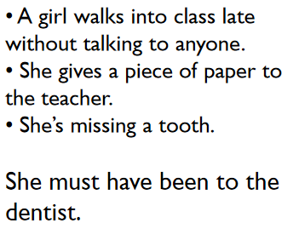
What do you think could have happened?

Slide 6
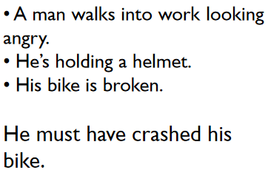
What do you think could have happened?

Slide 7
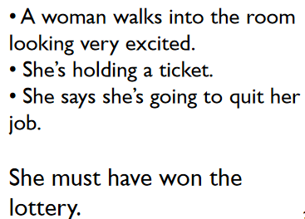
What do you think could have happened?

Slide 8
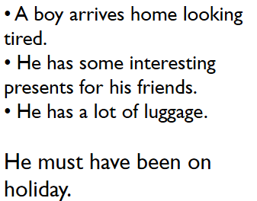
What do you think could have happened?

Slide 9
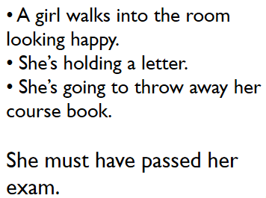
What do you think could have happened?

Slide 10
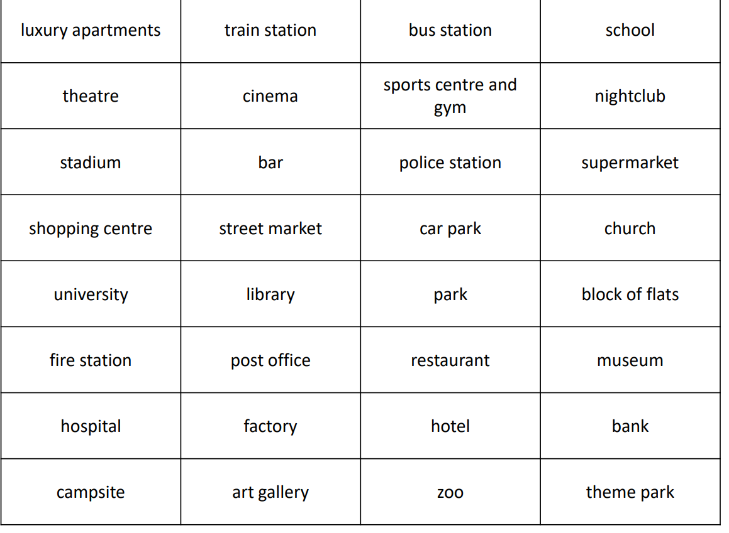
a | b | c | d
1
2
3
4
5
6
7
8

Slide 11
